Slide 1
Milestone Two
Nick Abcarius
Andrew Do
Travis Garcia
Nicole Pavlovich
Steven Tan
Notes:
nicole

Slide 2
Milestone Goals
Implement a buffer pool that interacts with disk storage to store and retrieve data
Add a merge function that periodically merges tail data with base data
Create an index class that allows the user to index on any column for query functions
Notes:
nicole

Slide 3
Bufferpool

Slide 4
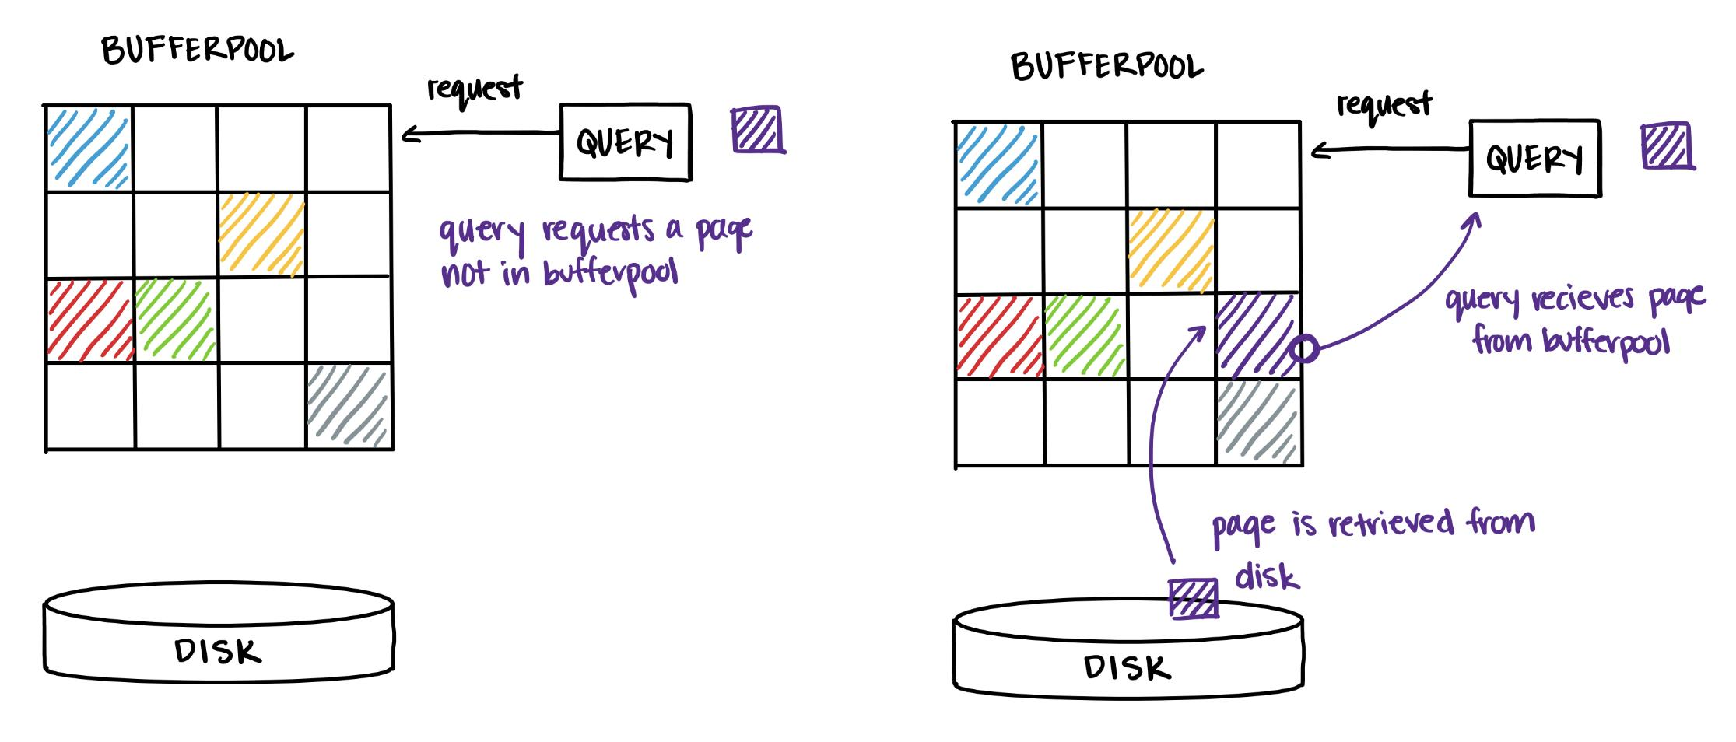
Bufferpool
The bufferpool stores database pages that are actively being manipulated
Main memory is faster to access than disk
However, information in the bufferpool is lost in the event of a crash
Therefore, all changes must be eventually copied back to disk
Queries ask for pages, which are returned from the bufferpool or acquired from disk if not already available
Pinned Pages: Pages currently in use by a transaction
Notes:
Nick
“We chose LRU over MRU because when we are writing several updates to a tail page, we don’t want a different thread to evict our page from the bufferpool. This could happen when the bufferpool is full, and another thread is trying to access a page outside of the bufferpool”
16 Page Bufferpool (power of 2 aligns with physical page and page size)
“we tested several values”
No log system currently, so no recovery from crashes
open() : Get the tables metadata files and loads it in
close() : Saves the tables metadata files and evicts the bufferpool to the disk

Slide 5
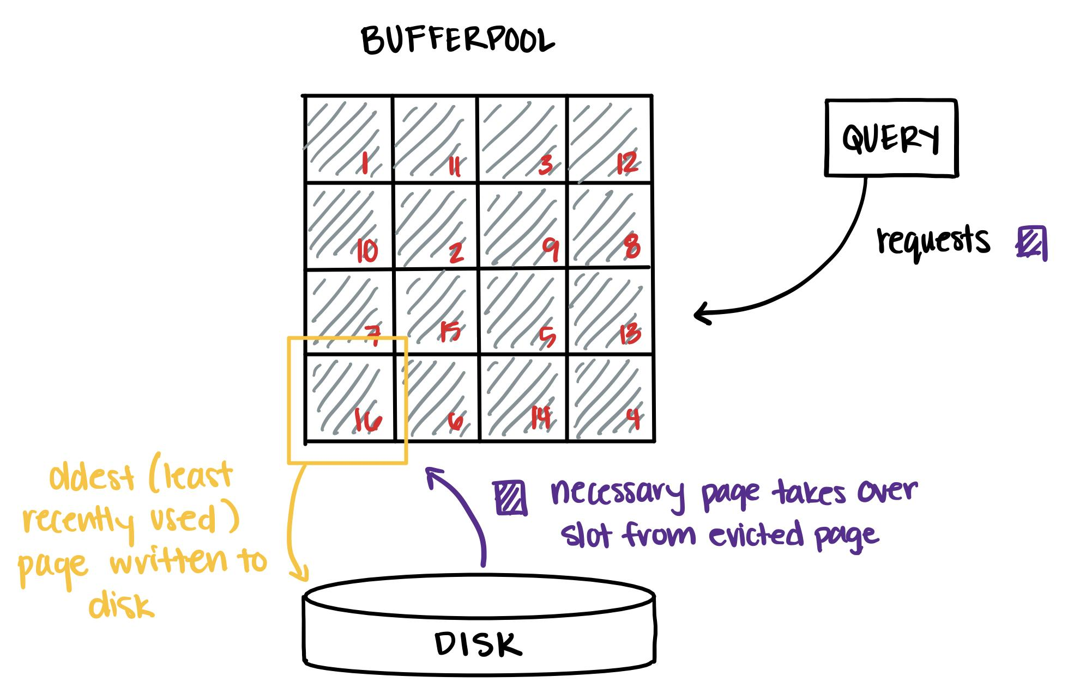
Bufferpool: Eviction
If the bufferpool is full and a page stored on disk is requested, eviction must occur
Dirty Page: A page in the bufferpool with changes not reflected in the disk
Eviction Policy: Least Recently Used, Page-level granularity
Each page is assigned an age that is updated each time the bufferpool is accessed
The oldest page is evicted when a new page is needed
page.py
def writePageToDisk(self, path) def readPageFromDisk(self, path) def writeToDisk(self, path) # physical page def readFromDisk(self, path) # physical page
Notes:
Andrew
“We chose LRU over MRU because when we are writing several updates to a tail page, we don’t want a different thread to evict our page from the bufferpool. This could happen when the bufferpool is full, and another thread is trying to access a page outside of the bufferpool”
16 Page Bufferpool (power of 2 aligns with physical page and page size)
“we tested several values”
Page level granularity for simplicity at the cost of efficiency

Slide 6
Merge

Slide 7
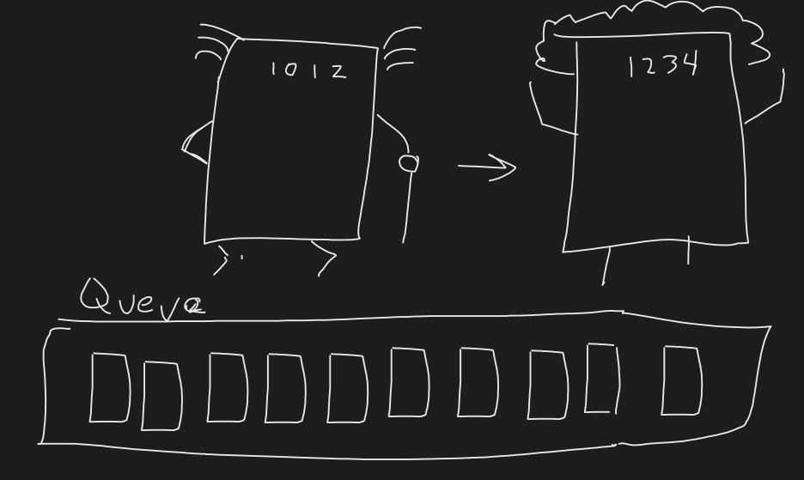
Merge Design
Purpose: Speeds up queries
Key Design: Asynchronous, lazy merging does not interrupt transactions and single pointer swaps ensures minimum contention
baseRID: Tail records store the baseRID in their metaColumns
Granularity: Global MergePolicy which defines how many tail pages inside a PageRange will be filled before a merge is initiated
Tail Page Sequence Number (TPS): Number per base page that tracks RID of the last tail record merged.
Notes:
Travis

Slide 8
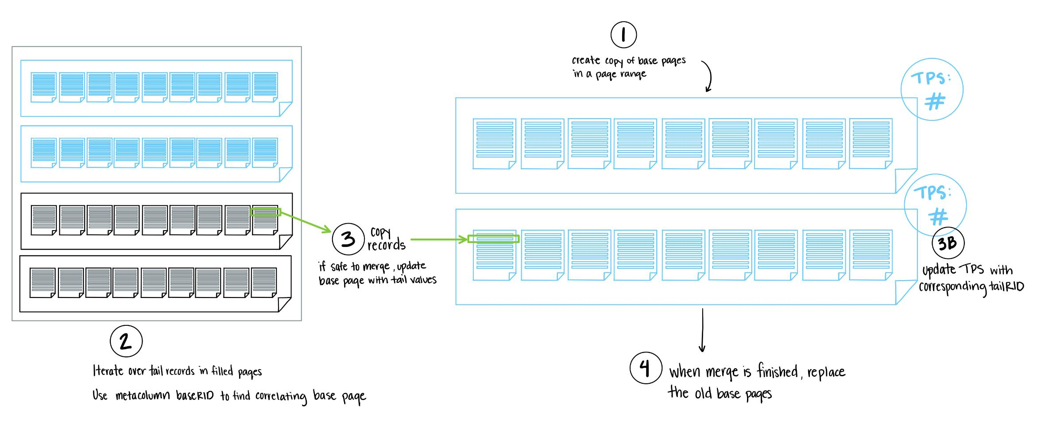
Merging Process
Note: After merge, if indirection value is less than TPS, record has been merged so return consolidated base record
Notes:
Merging Process
Make copy of all base pages in page range and start background thread
Iterate over all tail records in filled tail pages and use baseRID meta column to lookup base page
If base page is filled and therefore safe to merge, then update with tail data values and update TPS with latest consolidated tail record
In the main thread replace base data pages with merged data pages by updating file path
Select: if indirection value is less than TPS, record has been merged so return consolidated base record

Slide 9
Indexing

Slide 10
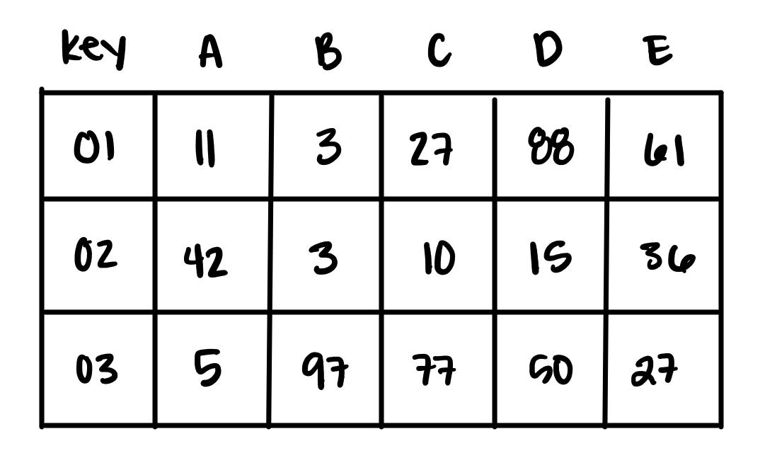
Indexing
Indexing is used to more effectively find and select records
The user can create an index on any column by using def create_index(self, column_number)
In this example, an Index on column B would allow the user to select(3) and would return both record 01 and 02
Previous iterations of index used a dictionary, and then a binary search tree, before settling on B-Tree
index.py
def __init__(self, table) def locate(self, column, value) def locate_range(self, begin, end, column) def create_index(self, column_number) def drop_index(self, column_number)
Notes:
Nicole
On this milestone, there is a focus on indexing on other columns besides the primary key and this allows more efficient searching
where users are able to search records based on values in other columns. Our On the example on the right,
the user can create an index on column B, with the create_index function and providing the column number. After indexing it,
if the user calls select(3) it will return all records with the value 3 in that specific column which is record 1 and 2.

Slide 11
Structure: Order 3 B-Tree
Node referencing multiple records via their RID
Sortable and Self-balancing
Improved search time (find is ⌈ log₂ N ⌉ comparisons)
Nodes:
Can be found by search key
Contain RIDs of matching records
Cons:
All internal and leaf nodes have data pointers, unlike B+ Tree
Leaf and non-leaf nodes are of different size
Deletion may occur in a non-leaf node
Video Credit (Link)
Key based on which column is indexed, holds a RID
Notes:
Steven
The way we index is using an order 3 b-tree where nodes are sorted and the tree self-balances. This allows improved search time as
locating a record will take roughly ceiling of logbase2 of N comparisons where n is the amount of keys in the tree.
When searching it will find all records with the given key and compare it with the values in the tree
It does this by creating a copy of the tree where it will recursively delete the record found and search again until no record is found.
Some disadvantages are that the RIDs are stored on leaf nodes as well as internal nodes instead of just the leaf like a B+ Tree
(all leafs are in the same depth allowing for easy access and location). This may causes complex deletion to occur in a non-leaf node as all leaf nodes are not connected by a linked list

Slide 12
Milestone Two
Nick Abcarius
Andrew Do
Travis Garcia
Nicole Pavlovich
Steven Tan
Notes:
andrew

Slide 13
Next Steps:
Test & debug with tools such as Python cProfiler to analyze functions for optimization
Implement concurrency, multithreading, and other ACID guarantees
Notes:
andrew

